Slide 1
Cluster sampling approach for multivariate survival data analyzing
Group members:
Qiyue He, Dinghao Wang, Pengkun Liang

Slide 2




Sections
01
02
03
04
Past
work
Theory
development
New
Approach
Conclusion&
reference

Slide 3
0
1
Past work
Andersen and Gill (AG) model (1982)
Segal and Neuhaus (1993)

Slide 4
Andersen and Gill (AG) model (1982)
In AG model,
each subject is treated as a multi-event countingprocess with essentially independent increments; PWP model is a conditional approach;
and WLW model is marginal method, in which one obtains the estimated coefficients, ignoring correlation, followed by fix of the variance of estimated coefficients.
Marginal
conditional
Counting process

Slide 5
Segal and Neuhaus (1993)
(GEE) machinery
Based on GEE application of quasi-likelihood which is essentially a special case of Binder’s method (Binder, 1983) applied to with-replacement cluster sampling.
Sandwich estimators
Robust inference was handled for variance estimates of estimated regressionparameters

Slide 6
0
2
Theory development

Slide 7




Some notations
Cox’s proportional hazards model
Data setting
where for observation k of individual j of treatment group i, Tijk denotes a failure time, δ ijk is an event indicator taking the value 1 if Tijk is uncensored and 0 otherwise, and xijk is a p-dimensional vector of covariates.

Slide 8
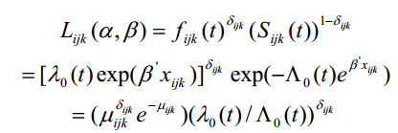

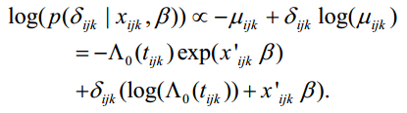

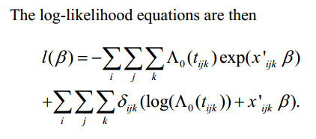
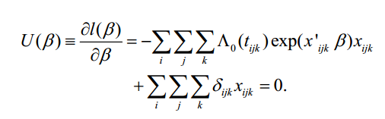
Some notations
treat δijk as if it were Poisson

Slide 9
0
3
New approach
Modified sandwich for variance

Slide 10
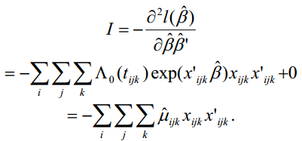







Modified sandwich

Slide 11




efficiency quantity
标题文本预设
1
标题文本预设
2
Sample mean
3

Slide 12
0
4
Conclusion
Experiment & comparson
Conclusion

Slide 13
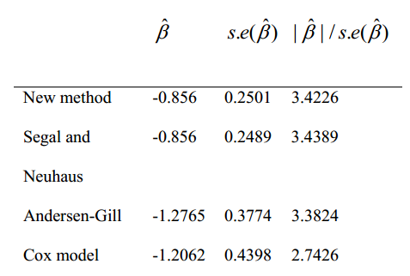
comparison
New approach method is effective to detect significance of the treatment effect (gamma interferon) though the coefficient is underestimated
The coefficients from our method and Segal and Neuhaus’s method with independent working correlation structure are the same

Slide 14
Conclusions
limitation
no time-dependent covariates are allowed
Better performance
more efficient in small samples cases
Better build
piecewise exponential
No need to specify covariance structure between the survival times in a cluster
Loose assumption and more flexible

Slide 15
Refference

Slide 16
Thanks
2020.04.20

